Slide 1
Crash-Safe Trading System
Building a zero-data-loss financial matching engine using POSIX Write-Ahead Logging.
C (GNU)
POSIX APIs
File I/O
Ubuntu/Linux

Slide 2

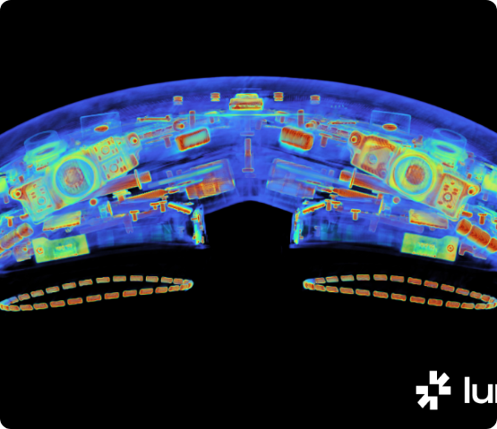
Problem Statement & Concept
>
The Problem: Financial trading systems process thousands of orders in RAM for ultra-low latency. If the server crashes (power loss, kernel panic, OOM killer), all in-memory data is permanently lost.
>
The Flaw of Standard I/O: Standard C library file writing (fwrite, fprintf) buffers data in the OS page cache. A sudden crash still results in data loss before it physically hits the disk.
>
The Solution (Concept): Implement a Write-Ahead Log (WAL). Every transaction is appended to a log file and strictly synchronized to the physical disk using hardware-level OS commands before the system updates the fast in-memory state.

Slide 3
System Interaction Flow
1. Startup & Recovery
2. Active Ingestion
The system boots, detects existing log files, and automatically replays history sequentially to reconstruct the exact database memory state.
The system waits for trading orders, running entirely in high-speed RAM while safely logging transactions to the WAL in the background.
3. Graceful Shutdown
4. Disaster Simulation
User issues a stop command. The OS signal is caught, remaining memory buffers are safely flushed, and file descriptors close safely.
The user forces a hard crash via Linux terminal (kill -9). The system reboots and proves 100% data retention of committed orders.

Slide 4
Core OS Concepts
Synchronous I/O
Data Packing
Utilizing fdatasync() bypasses the OS page cache, forcing the NVMe/SSD storage controller to physically write the data before the program thread is allowed to continue execution.
Using __attribute__((packed)) disables standard C compiler padding to ensure memory structs align identically with raw disk bytes, preventing cross-architecture corruption.
Signal Handling
Atomicity
Intercepting OS interrupts (like SIGINT via sigaction) prevents immediate termination, allowing the program to safely clean up resources and exit gracefully.
Writing in fixed-size binary blocks ensures a write either completes fully or fails entirely. The system validates the exact byte count written to prevent state corruption.

Slide 5
Implementation Working Flow
Phase 1: Recovery
Phase 3: Commit
Seek to byte 0. Read chunks matching the exact struct size. Rebuild total volume and order counts.
Only after hardware disk sync returns success, update the fast in-memory variables.
Initialization
Phase 2: Durability
Register OS signal handlers and open engine_wal.dat using O_RDWR | O_CREAT | O_APPEND.
Intercept new order. Call write() to OS buffer, then fdatasync() to physical disk.

Slide 6
Algorithm & Technical Logic
Write-Ahead Algorithm
Recovery Algorithm
write_order(file_desc, new_order): bytes = write(file_desc, new_order) if bytes != struct_size: return ERROR status = fdatasync(file_desc) if status != 0: return ERROR // Only runs if hardware confirms update_memory_state() return SUCCESS
recover_state(file_desc): // Jump to start of WAL lseek(file_desc, 0, SEEK_SET) // Read exactly one struct at a time while read(file_desc, buffer) == struct_size: rebuild_state(buffer) return SUCCESS

Slide 7
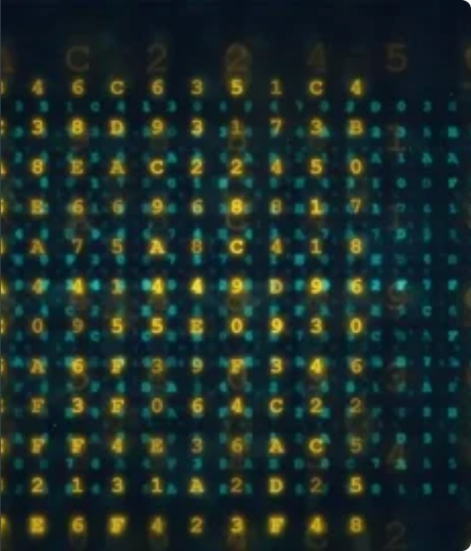
Core Data Structure
The system relies on a meticulously defined C struct. By preventing compiler padding, the exact 25-byte footprint in RAM translates perfectly to the disk layout. We use open() instead of fopen() to maintain strict control over file descriptors.
typedef struct __attribute__((packed)) { uint32_t order_id; // 4 bytes char symbol[8]; // 8 bytes uint32_t quantity; // 4 bytes double price; // 8 bytes char side; // 1 byte ('B'/'S') } Order; // Total: exactly 25 bytes

Slide 8
Step-by-Step Execution
01
Order Ingestion: System generates Order #1: BUY 50 AAPL @ $155.00.
02
OS Buffer Write: write() syscall pushes the 25-byte struct from program memory into the OS kernel page cache.
03
Hardware Sync: fdatasync() blocks the executing thread. The kernel explicitly instructs the storage controller to flush its volatile cache.
04
Controller Confirmation: The storage hardware replies "Done" to the kernel. fdatasync() returns control to the program.
05
Memory Update & Acknowledge: The system increments total_orders in RAM and outputs [COMMITTED] ID: 1 to the user interface.

Slide 9
System Behaviour Analysis
Scenario | Trigger | System Behavior | Data Status
Graceful Exit | User types q or Ctrl+C | Signal caught. Main loop breaks cleanly. File descriptors are closed safely via code. | 100% Safe
Hard Crash | kill -9 or sudden power out | OS kills process instantly. No cleanup code or signal handlers are allowed to execute. | 100% Safe (via fdatasync)
Storage Failure | Disk Full / I/O Hardware Error | write() or fdatasync() catches OS error and returns -1. Memory is bypassed. | Order Rejected Safely

Slide 10
Testing & Validation
Compilation & Standard Testing
Disaster Simulation
Tool: gcc -Wall -O2 crash_safe.c -o engine
Crash Trigger: Execute trades, then run kill -9 from a secondary terminal.
Graceful Test: Run the binary, execute trades, press 'q'. Restart the system.
Validation: Restarting the engine proves all trades executed milliseconds before the crash are perfectly recovered.
> ./engine
--- Starting Crash Recovery ---
[Recovered] ID: 1 | B 50 AAPL @ $155.00
Recovery Complete. Total Orders: 1
Binary Inspection:
> hexdump -C engine_wal.dat
0000000 01 00 00 00 41 41 50 4c ... AAPL

Slide 11

Conclusion & Takeaways
Key Project Achievement
Successfully implemented fundamental database durability (the 'D' in ACID) entirely from scratch using raw OS POSIX system calls, completely bypassing standard library abstractions.
The Trade-off
Future Architecture Evolution
We sacrificed absolute maximum system throughput (due to blocking hardware disk I/O on every single order) to gain 100% guaranteed crash survivability.
To scale to millions of TPS, the next step is implementing a Lock-Free Ring Buffer to batch orders, allowing the OS to sync 1,000+ orders to disk simultaneously.

